Slide 1
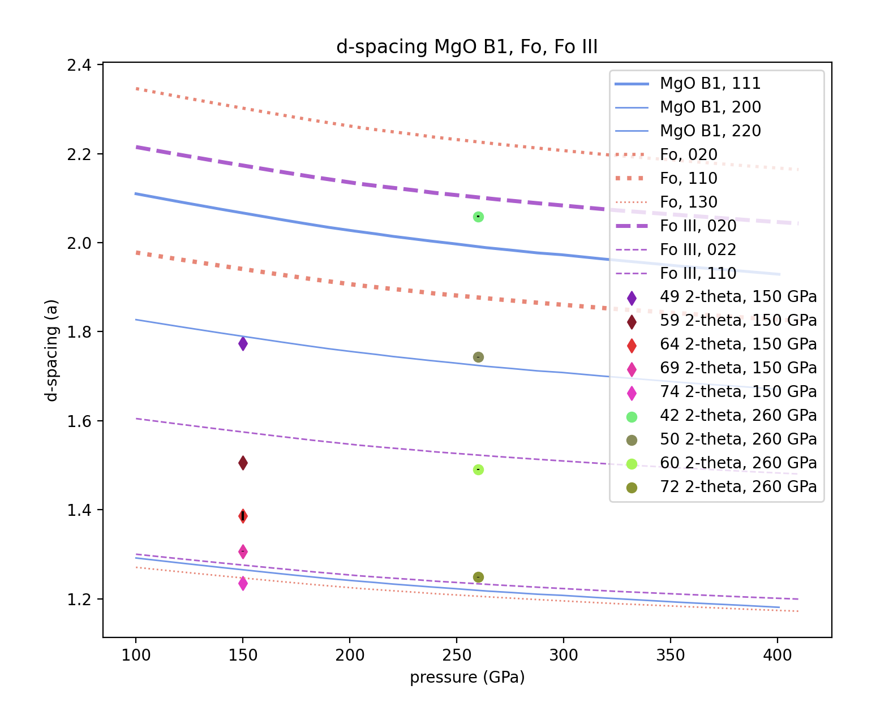

Slide 2
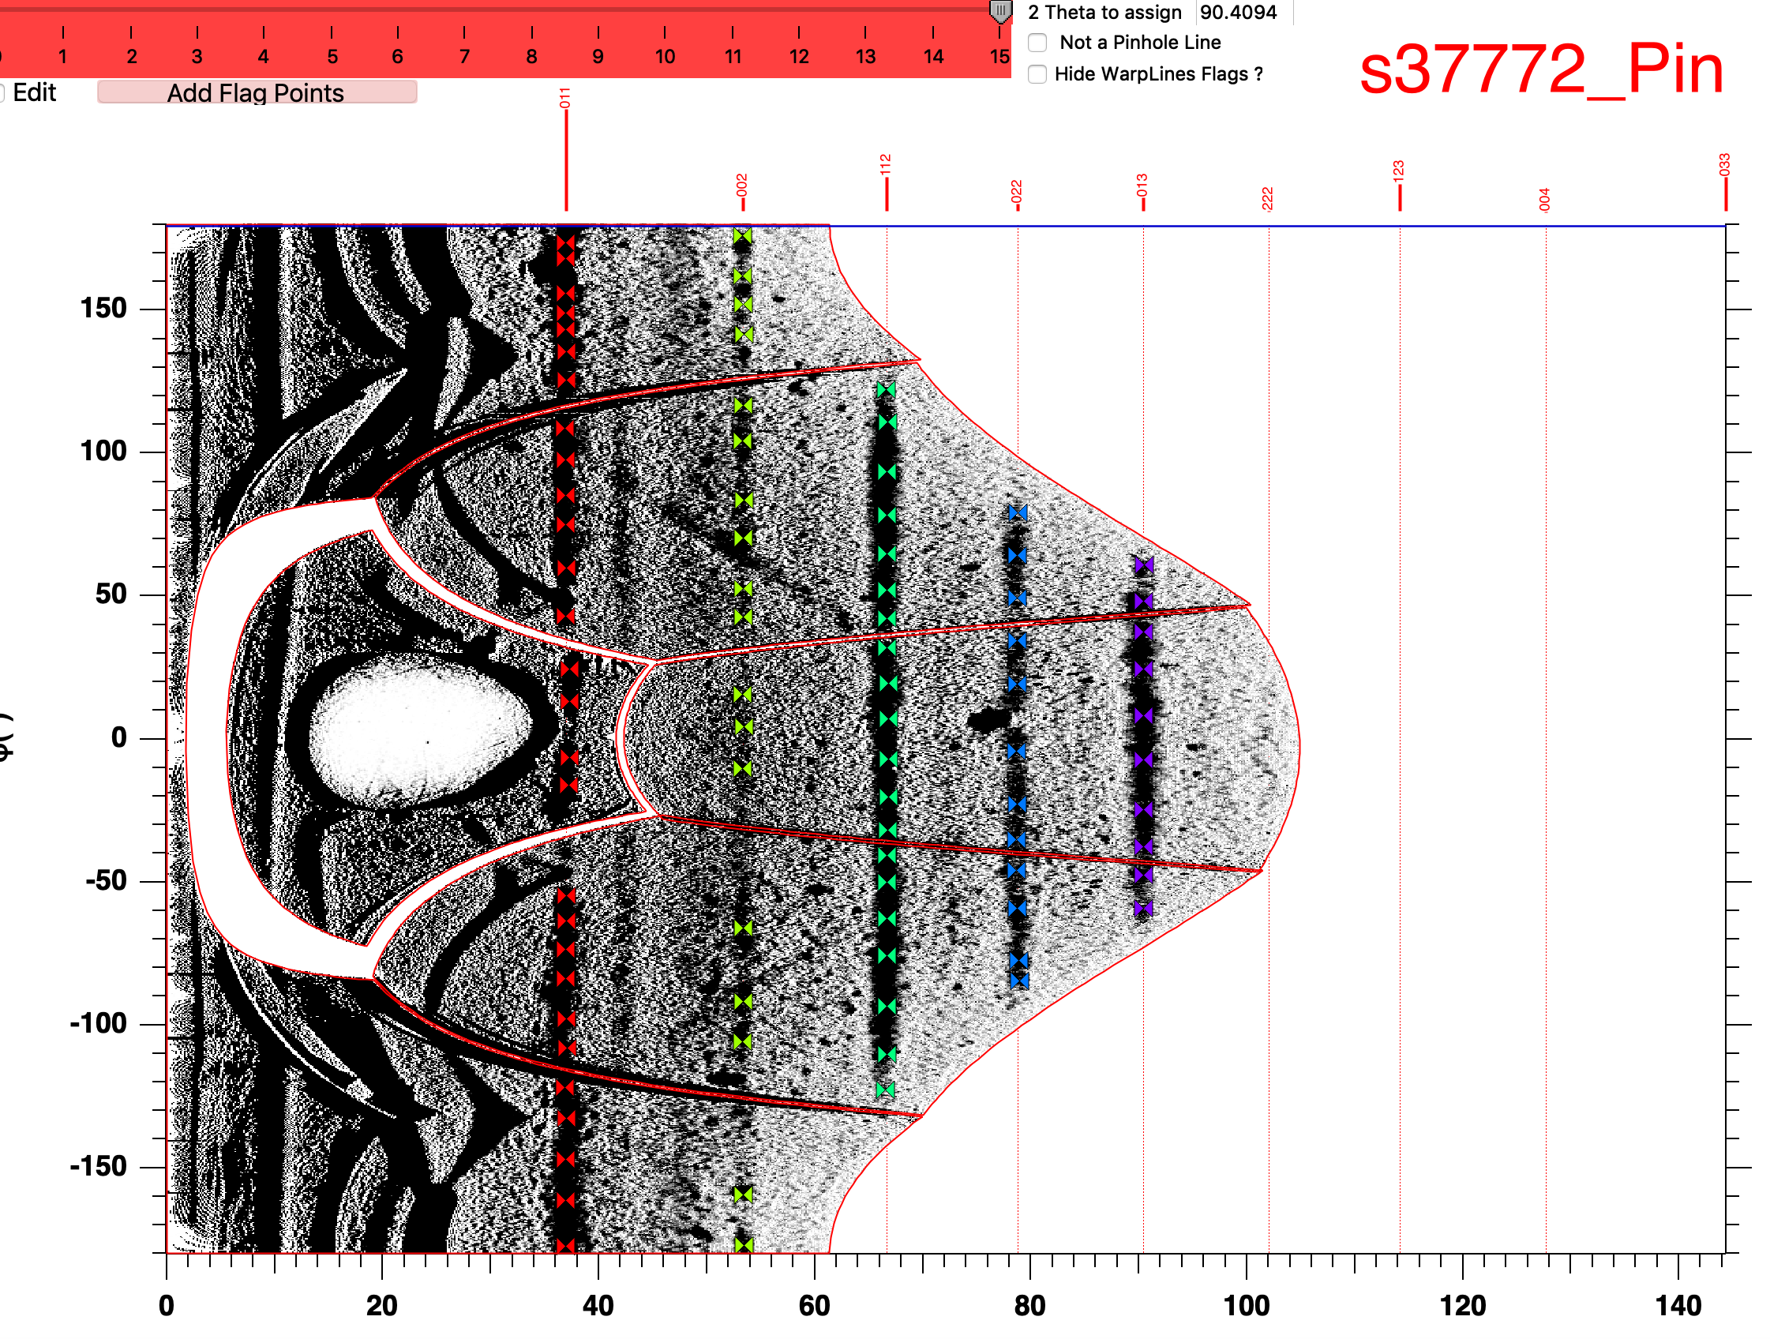
Higher pressure darker colorscale pinhole

Slide 3
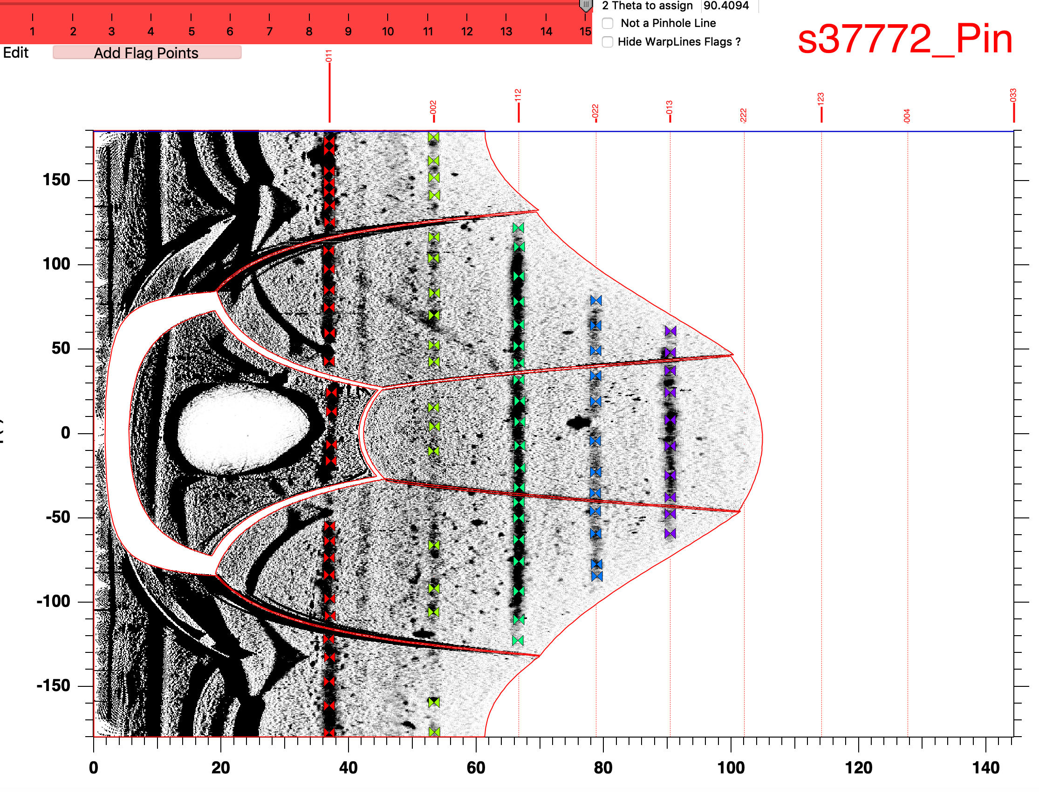
Higher pressure lighter colorscale pinhole

Slide 4
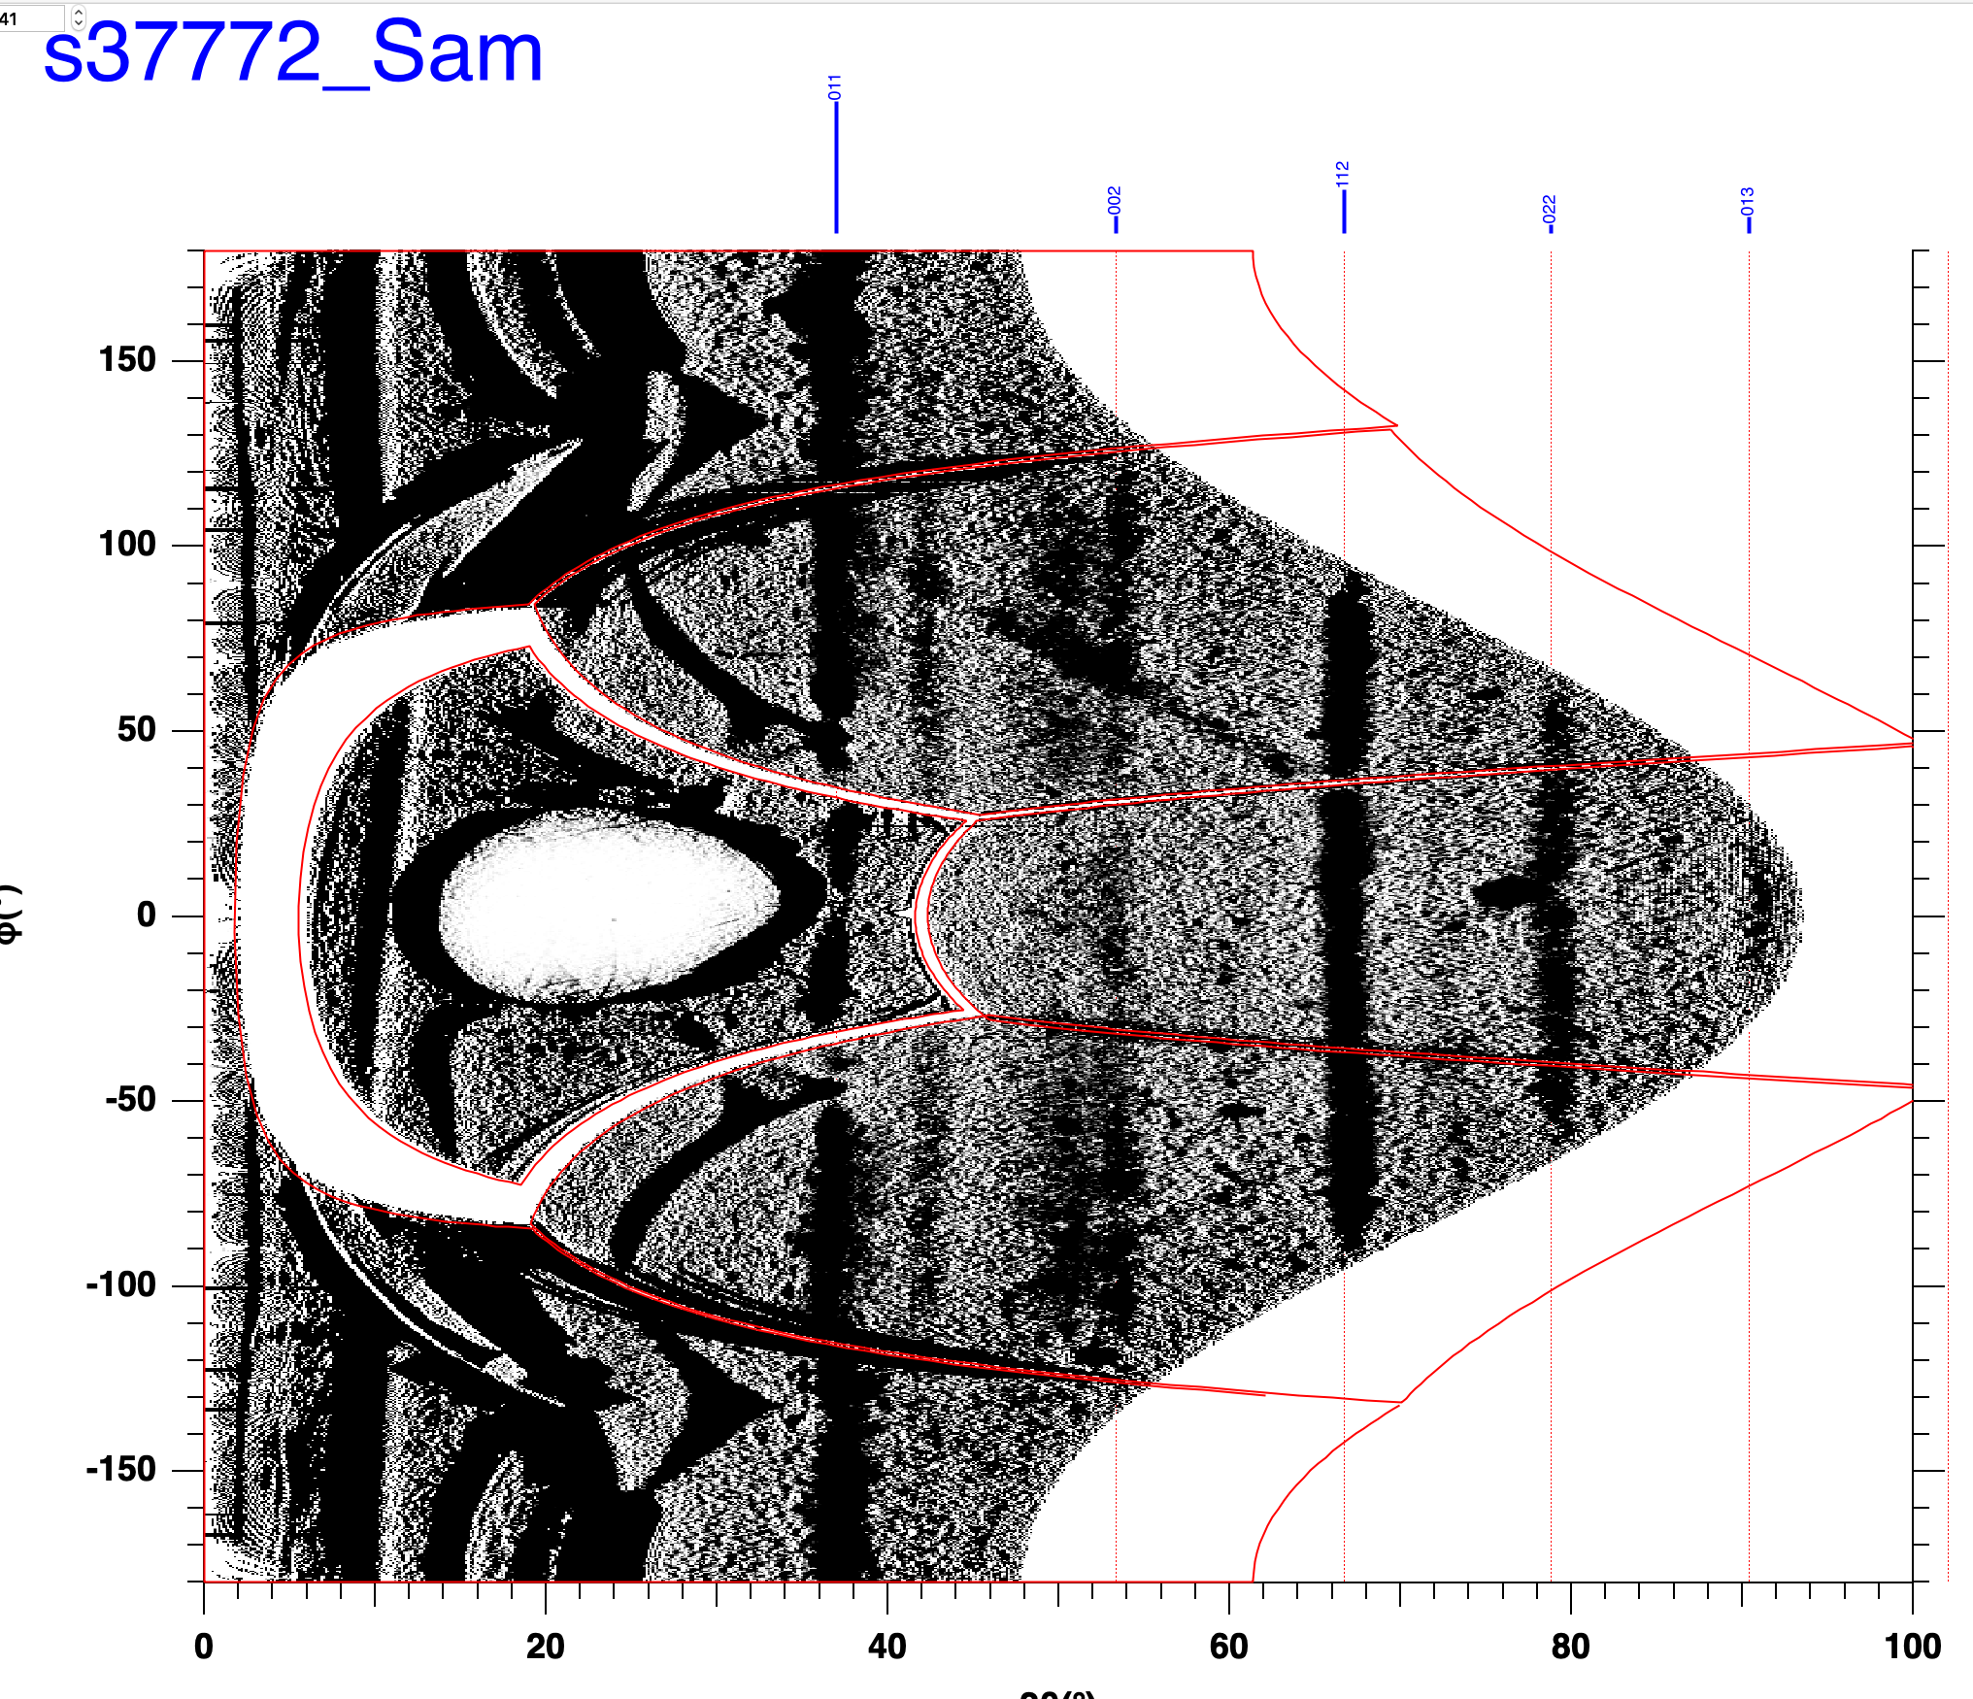
Higher pressure darker sample

Slide 5
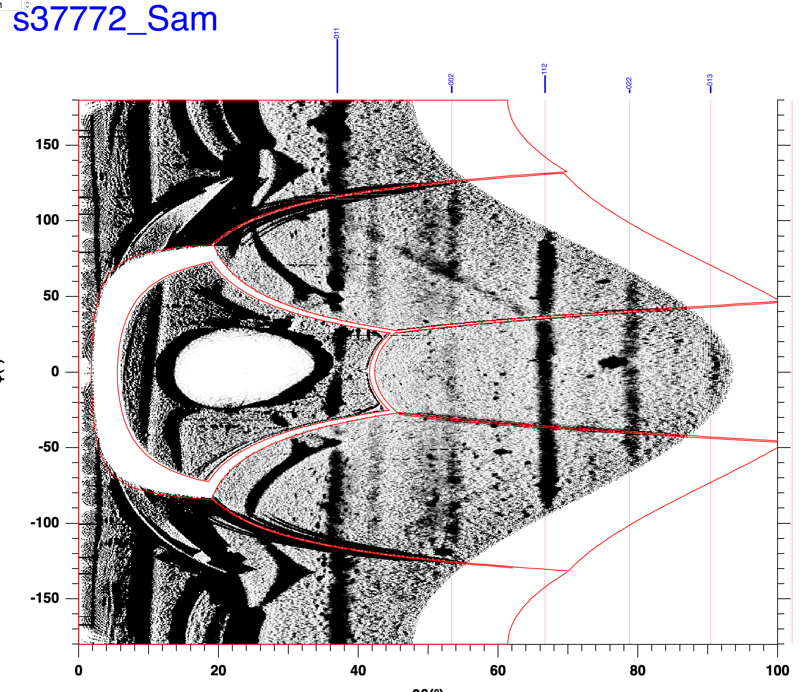
Higher pressure lighter sample

Slide 6
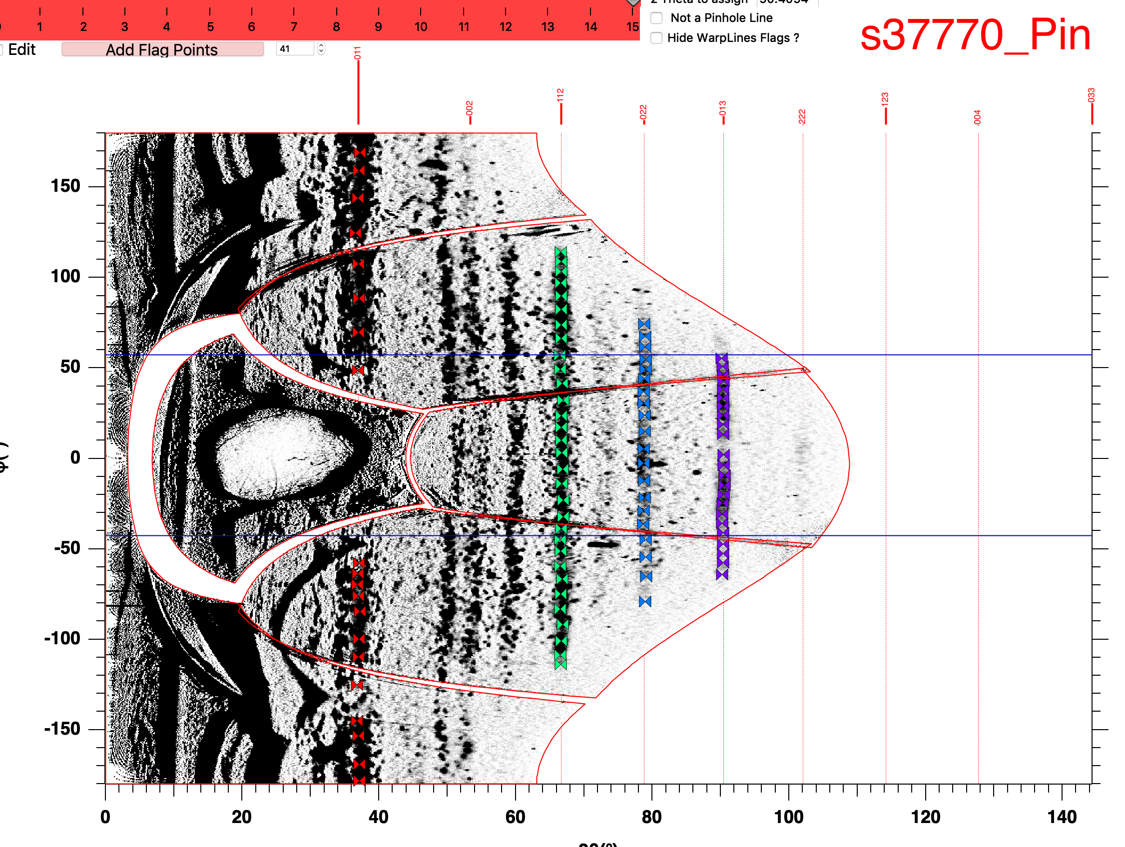
Lower pressure pinhole

Slide 7
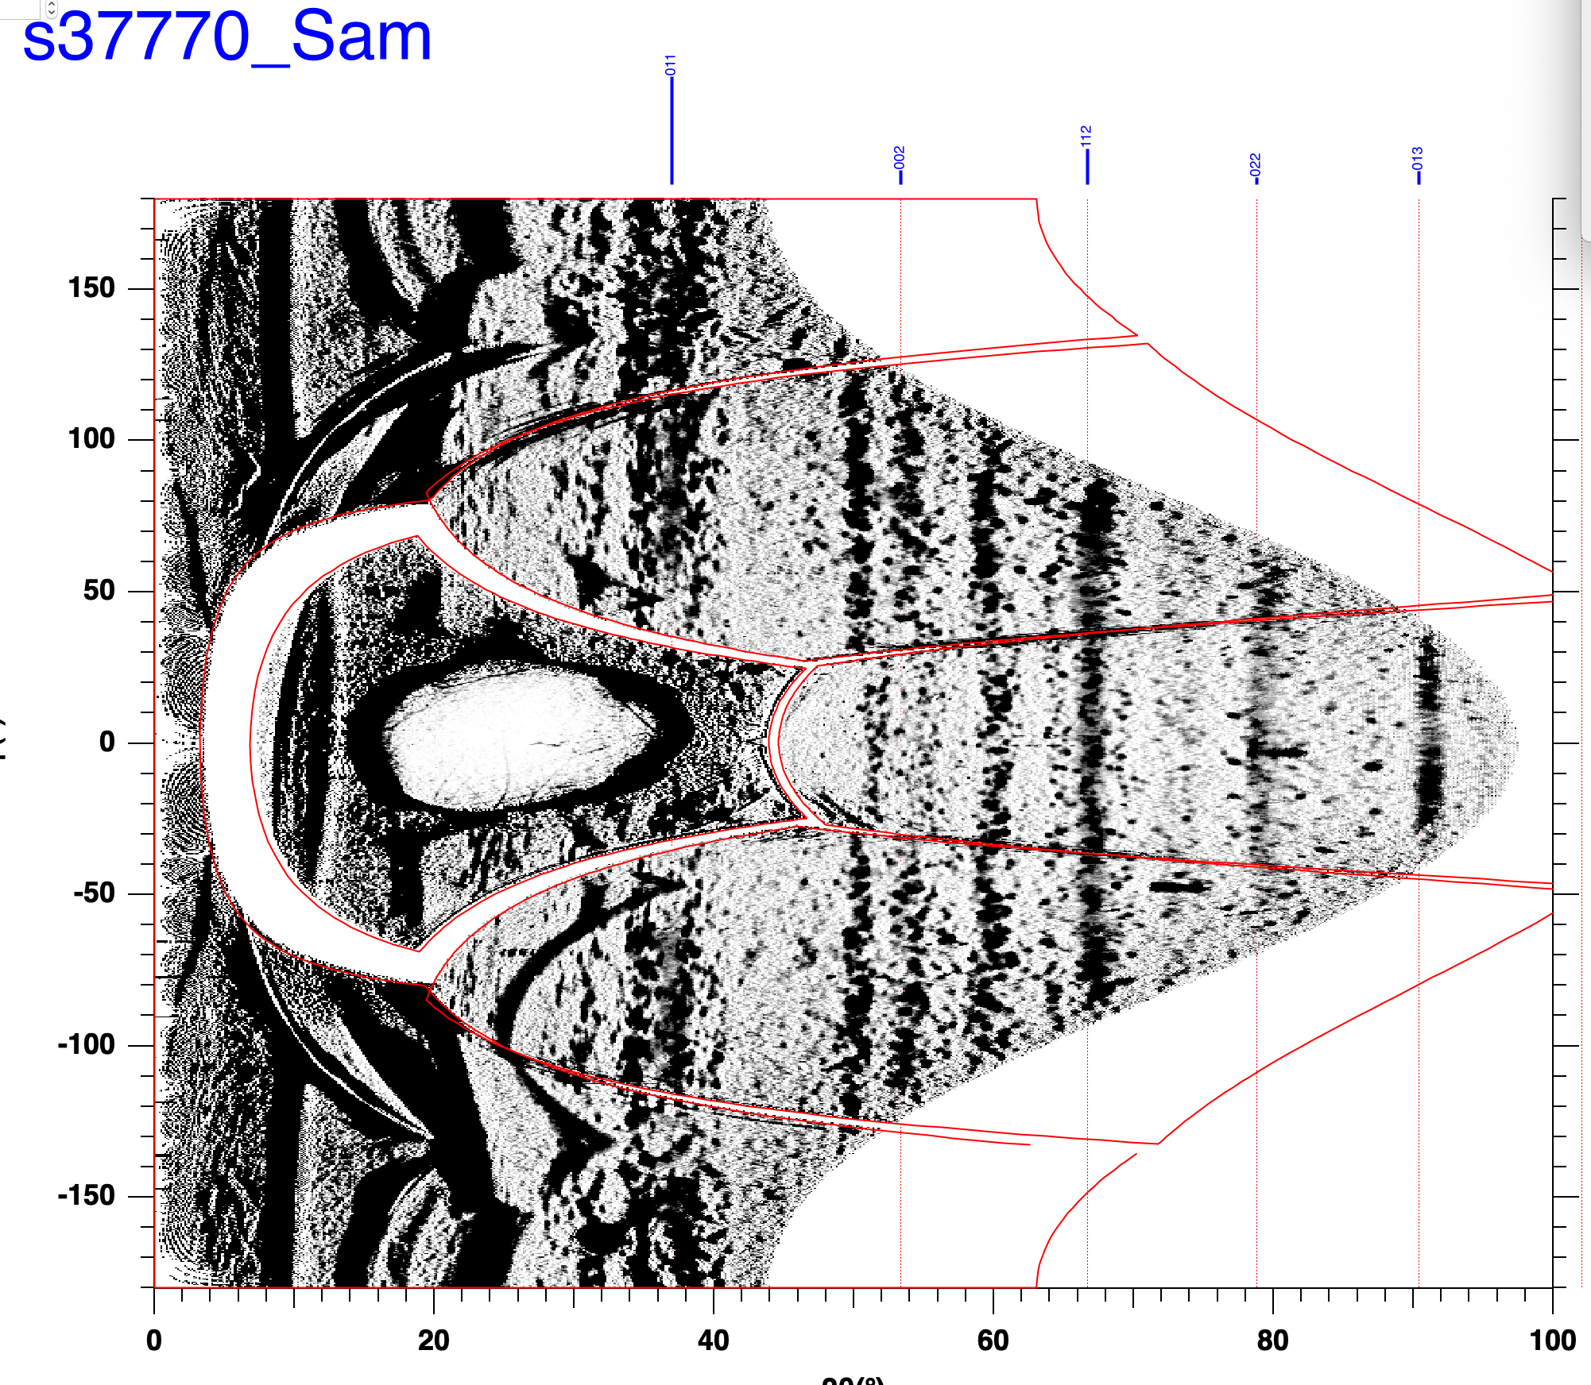
Lower pressure sample

Slide 8
37770 - 150 GPa
37772 – 260 GPa
I will redo the alignment for 37770 later

